Slide 1
Data Structures Chapter 2-4
Performance Analysis
Big-O Notation
Big-O Properties
Growth Rates

Slide 2
Big-O의 특성들을 알고 실제 코드에서
Big-O를 적용하는 규칙들을 배운다

Slide 3
Agenda
Big-O Notation
Asymptotic Analysis
Big-O Properties
Calculating Big-O

Slide 4
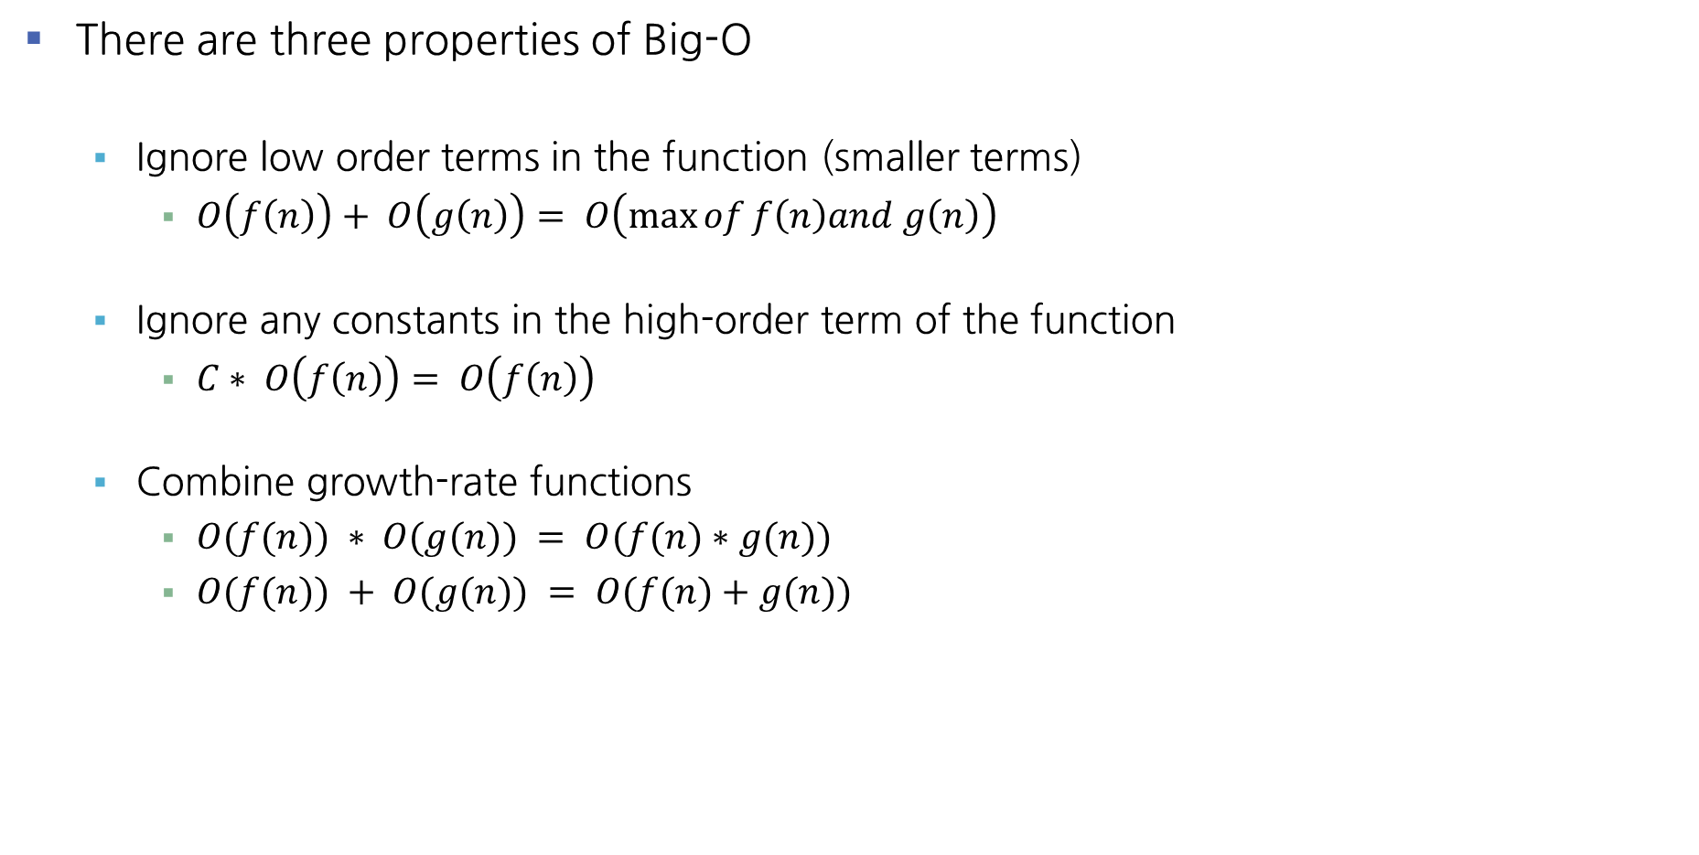
4 Properties of Big-O
There are three properties of Big-O
Ignore low order terms in the function (smaller terms)
$O\left(f\left(n\right)\right)+ O\left(g\left(n\right)\right)= O\left(\max{of}f\left(n\right)and g\left(n\right)\right)$
Ignore any constants in the high-order term of the function
$C∗ O\left(f\left(n\right)\right)= O\left(f\left(n\right)\right)$
Combine growth-rate functions
$O(f(n)) ∗ O(g(n)) = O(f(n)∗g(n))$
$O(f(n)) + O(g(n)) = O(f(n)+g(n))$

Slide 5
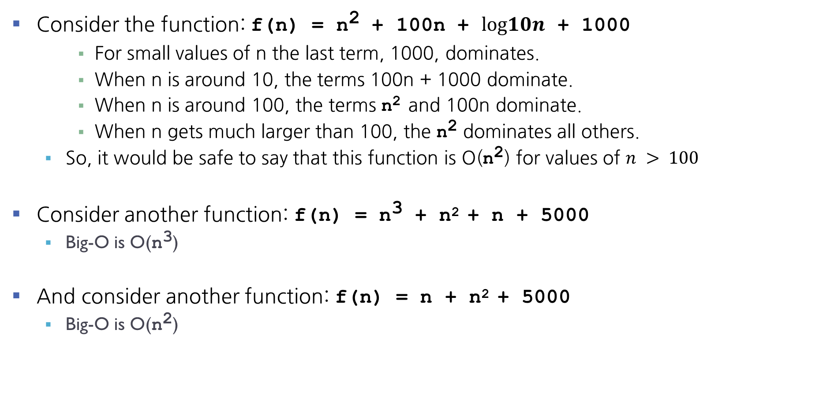
4 Properties of Big-O - Ignore low order terms
Consider the function: f(n) = n² + 100n + $log10n$ + 1000
For small values of n the last term, 1000, dominates.
When n is around 10, the terms 100n + 1000 dominate.
When n is around 100, the terms n² and 100n dominate.
When n gets much larger than 100, the n² dominates all others.
So, it would be safe to say that this function is O(n²) for values of $n > 100$
Consider another function: f(n) = n³ + n² + n + 5000
Big-O is O(n³)
And consider another function: f(n) = n + n² + 5000
Big-O is O(n²)

Slide 6
4 Properties of Big-O - Ignore any Constant Multiplications
Consider the function:
f(n) = 254 * n² + n
Big-O is O(n²)
Consider the function:
f(n) = n / 30
Big-O is O(n)
And consider another function:
f(n) = 3n + 1000
Big-O is O(n)

Slide 7
4 Properties of Big-O - Combine growth-rate functions
Consider the function:
f(n) = n * log n
Big-O is O(n log n)
Consider another function:
f(n) = n² * n
Big-O is O(n³)

Slide 8

4 Properties of Big-O - Exercise 2
What is the Big-O performance of the following growth functions?
T(n) = n + log(n)
T(n) = $n^{4}$ + n*log(n) + 300 $n^{3}$
T(n) = 300n + 60 * n * log(n) + 342

Slide 9

4 Properties of Big-O - Exercise 2
What is the Big-O performance of the following growth functions?
T(n) = n + log(n) O(n)
T(n) = $n^{4}$ + n*log(n) + 300 $n^{3}$ O($n^{4}$)
T(n) = 300n + 60 * n * log(n) + 342 O(n log n)

Slide 10
5 Calculating Big-O
We will investigate rules for finding out the time complexity of a piece of code
Straight-line code
Loops
Nested Loops
Consecutive statements
If-then-else statements
Logarithmic complexity

Slide 11
5 Calculating Big-O - Rules
Rule 1: Straight-line code
Big-O = Constant time O(1)
Does not vary with the size of the input
Example:
Assigning a value to a variable
Performing an arithmetic operation.
Indexing a list element
Rule 2: Loops
The running time of the statements inside the loop (including tests) times the number of iterations
Example:
Constant time * n = c * n = O(n)
x = a + b;
i = y[2];
for (auto i: range(n))
cout << i;
executed n times
constant time

Slide 12
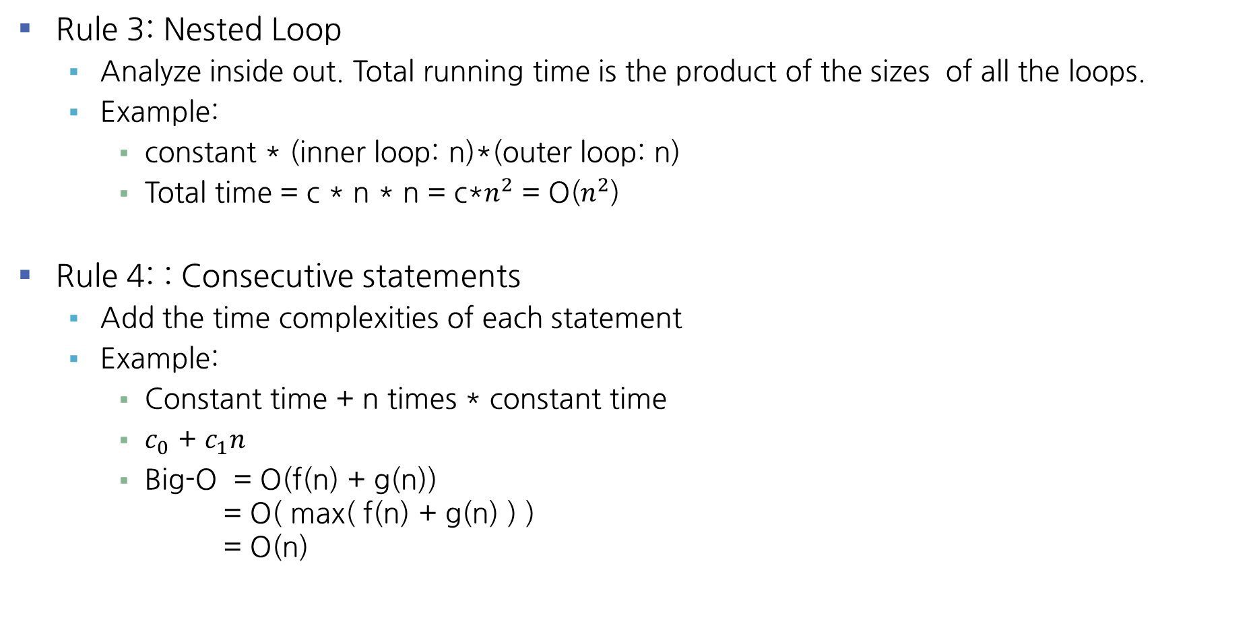
5 Calculating Big-O - Rules (con’t)
Rule 3: Nested Loop
Analyze inside out. Total running time is the product of the sizes of all the loops.
Example:
constant * (inner loop: n)*(outer loop: n)
Total time = c * n * n = c*$n^{2}$ = O($n^{2}$)
Rule 4: : Consecutive statements
Add the time complexities of each statement
Example:
Constant time + n times * constant time
$c_{0}$ + $c_{1}n$
Big-O = O(f(n) + g(n)) = O( max( f(n) + g(n) ) ) = O(n)
executed n times
for (auto i: range(n))
for (auto j: range(n))
k = i + j;
x = x + 1;
for (auto i:range(n))
m = m + 2;
constant time

Slide 13

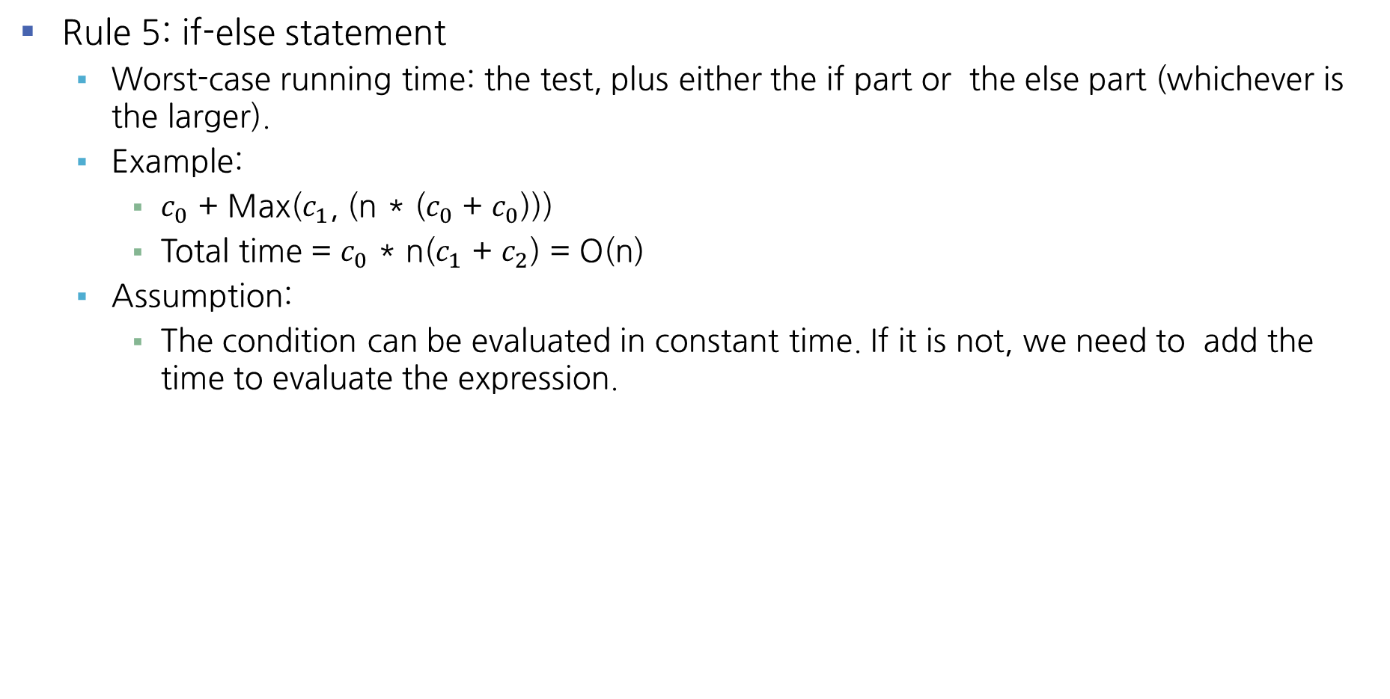


5 Calculating Big-O - Rules (cont.)
Rule 5: if-else statement
Worst-case running time: the test, plus either the if part or the else part (whichever is the larger).
Example:
$c_{0}$ + Max($c_{1}$, (n * ($c_{0}$ + $c_{0}$)))
Total time = $c_{0}$ * n($c_{1}$ + $c_{2}$) = O(n)
Assumption:
The condition can be evaluated in constant time. If it is not, we need to add the time to evaluate the expression.
if (asize != bsize)
return false;
else:
for (auto i: range(asize))
if (a[i] != b[i])
return false;
Test: constant time $c_{0}$
True Case: constant time $c_{1}$
False Case: executed n times
Another if: constant $c_{2}$ + constant $c_{3}$

Slide 14
5 Calculating Big-O - Rules (cont.)
Rule 6: Logarithmic
An algorithm is O(log n) if it takes a constant time to cut the problem size by a fraction (usually by ½)
Example:
Finding a word in a dictionary of n pages
Look at the center point in the dictionary
Is word to left or right of center?
Repeat process with left or right part of dictionary until the word is found
Example:
Size: n, n/2, n/4, n/8, n/16, . . . 2, 1
If n = 2^{K}, it would be approximately k steps. The loop will execute log k in the worst case (log₂n = k). Big-O = O(log n)
Note: we don’t need to indicate the base. The logarithms to different bases differ only by a constant factor.
size = n;
while (size > 1)
// O(1) stuff
size /= 2;

Slide 15
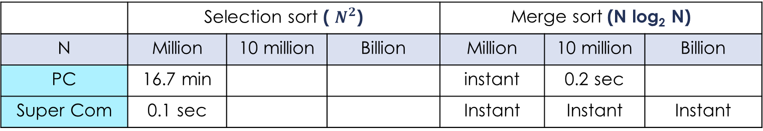


Exercise
Example: Running time estimates - empirical analysis
Personal computer executes ${10}^{9}$ compares/second
Super-computer executes ${10}^{13}$ compares/second
 | Selection sort ( $N^{2}$) |  |  | Merge sort (N log₂ N)
N | Million | 10 million | Billion | Million | 10 million | Billion
PC | 16.7 min |  |  | instant | 0.2 sec
Super Com | 0.1 sec |  |  | Instant | Instant | Instant
$$\log_{10}2≅0.3$$
$$86,400sec/day$$
instant < 0.1 sec
Use a reasonable or understandable time units.
Do not say, for example, "3660 days" nor "1220 seconds",
but 10.0 years or 20.3 min, respectively.
※ Bottom line: Good algorithms are better than supercomputers.

Slide 16
Summary
Big-O Notation is a mathematical formula that best describes an algorithm’s performance.
Big-O notation is often called the asymptotic notation (점근적 표기법) since it uses so-called the asymptotic analysis (점근적 분석) approach.
Normally we assume worst-case analysis, unless told otherwise.
In some cases, it may need to consider the best, worst and/or average performance of an algorithm

Slide 17
Big-O는 점근적 분석법(asymptotic analysis)을 사용한다
코드에서는 straight line, loop, logarithm 등을 기준으로 Big-O를 설정한다

